Slide 1
PROJECT PRESENTAION
23F-0551 Taimoor Ahmad
23F-0621Nauman Jaffar
23F-0645 Samiullah

Slide 2
MetroStyleHub
GLANCE OF YOUTH

Slide 3
INTRODUCTION:
Our project is about an ecommerce website.
The website has following pages:
Home
Men’s collection
Women’s collection
About us
Contact us
Feedback
Our services

Slide 4
MetroStyleHub:
MetroStyleHub is a fashion brand whose ethos is to have luxurious fashion, and rapid response to their customers.
Increases brand loyalty.
A professionally designed logo according to international standards.
Designers branding , sense of style and true essence of simplicity and youth.
MetroStyleHub focuses not only on creating great designs that are trendy and affordable but also on increasing its profitability all the time.

Slide 5

DETAILS:
In this website we used CSS styling format:
Inline
Internal
External
Our logo is created like using Canva to make
it more attractive to our customers as curves in the lines represents boldness
and straight lines represents the simplicity.
Darked theme is followed throughout the website
Also at homepage a background video is attached

Slide 6

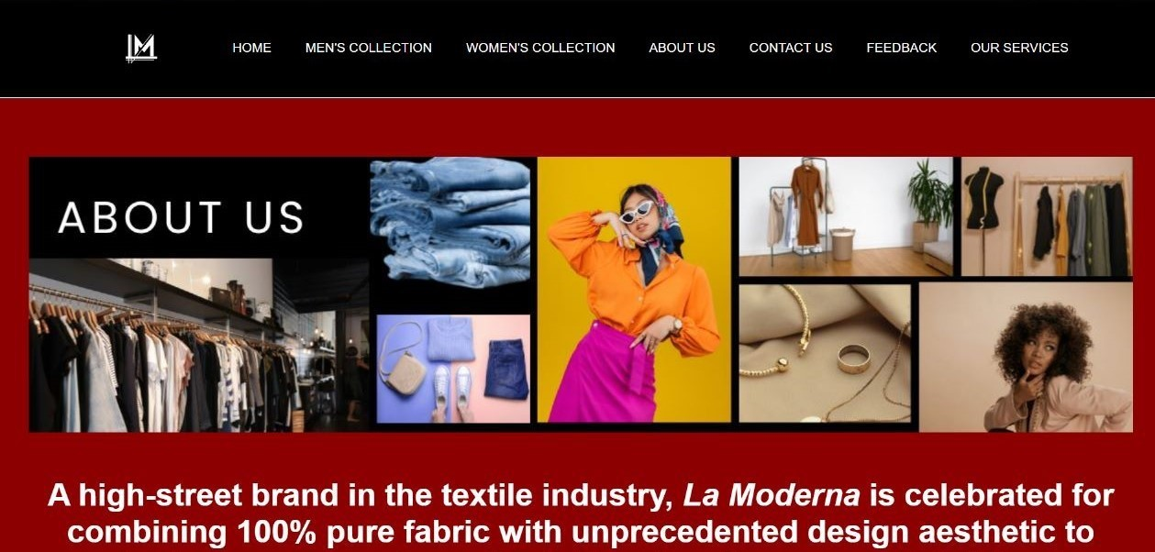
ABOUT US PAGE:
Clearly demonstrates the right way to describe the base and foundation of the brand.
It clearly glorifies the every aspect of information regarding website and brand.
The header and footer of the website demonstrates the true experience of modernization , simplicity, luxury and boldness.
About us page modifies the theme of youth in every circumstance and specifies the methodology and preserved techniques of modern marketing and business tactics.
It also magnifies the catchy and attractive glance of customer towards the website and brand.

Slide 7
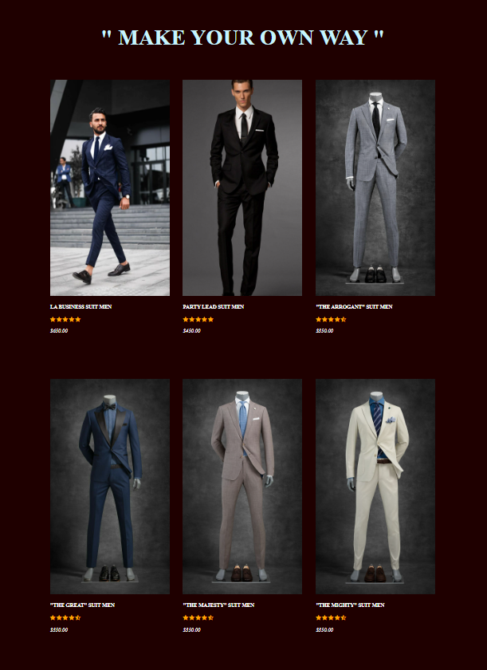
MEN’S COLLECTION PAGE:
To purify the taste of World-Leading Brands and luxury in every angle this page of Men’s Collection covers the every detail of product.
This page not only specifies products but it also have the latest and perfect pic of every product.
Every product have its own unique name with a bold effect in it to perfectionate its uniqueness and simplicity.
To dignify the greatness of each product the rating of each product is also added in this page.
For the customer better purchasing experience, price of every product is also added in US DOLLARS $ to hit the website in International market.

